Slide 1
Music Genre Classification
Afrina fardous
1512009042
Cse-465 section-02

Slide 2
Our dataset
We used public GTZAN dataset.
The Dataset consists of 10 genre classes each including 100 .wav files
The classes are:
Blues
Classical
Country
Disco
Hip-hop
Jazz
Metal
Pop
Reggae
Rock

Slide 3
Method
Logistic Regression

Slide 4
Features Extraction
Using Librosa library we calculated the features of
centeroid
roloff
zcr
rms and
flux
And for each feature we calculated
mean
std
kurtosis and
skew
We did mfcc treatment and calculated tempo.
After computing our feature shape was (1000,74)

Slide 5
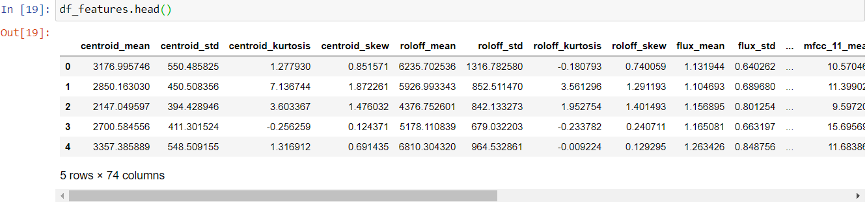
Features extraction contd.

Slide 6
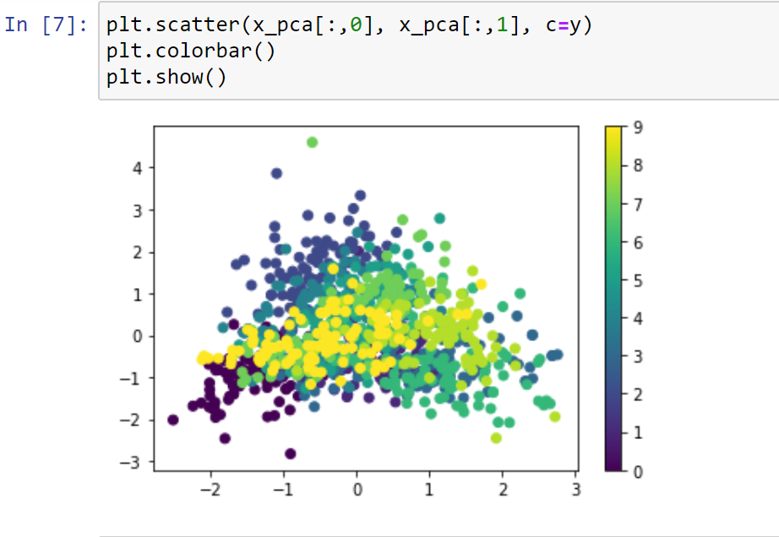
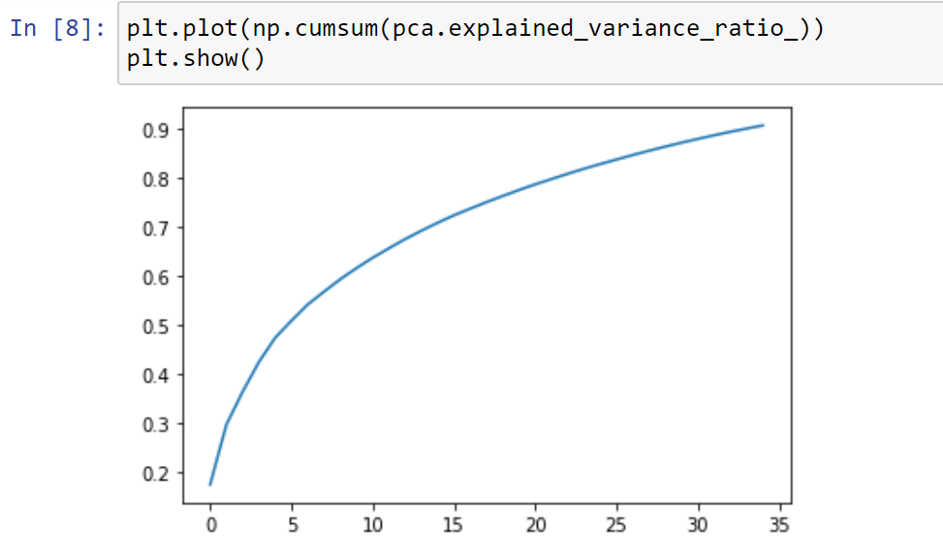
visualization
Principal Component Analysis
Variance Ratio

Slide 7
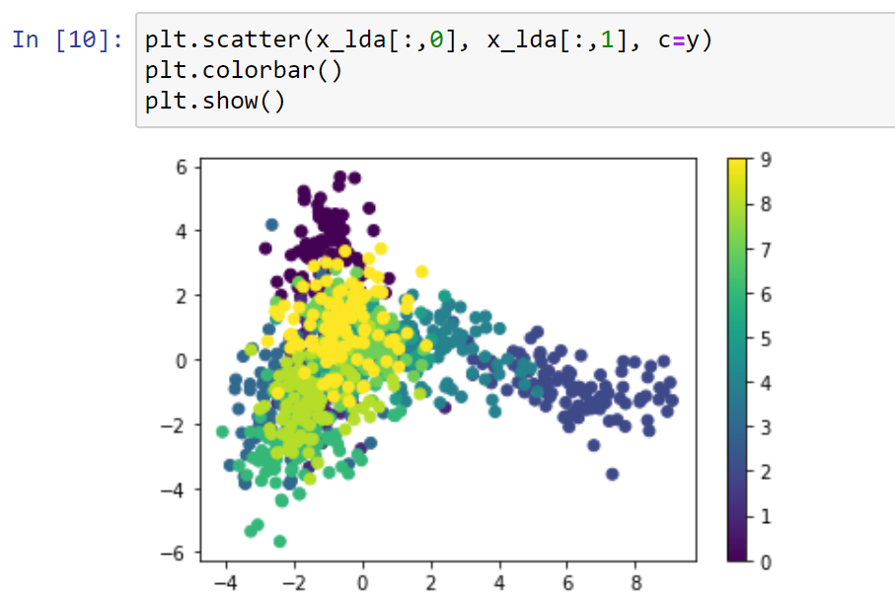
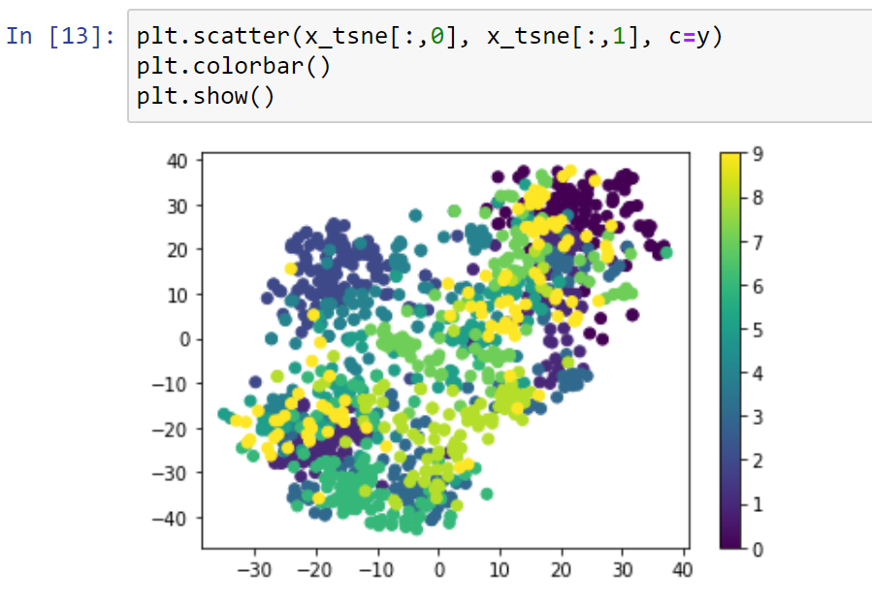
Visualization contd.
Scatter Plot
T-SNE Scatter Plot

Slide 8


Logistic regression
Penalty = 12 and C = 1
For K-Fold confusion matrix k=5

Slide 9
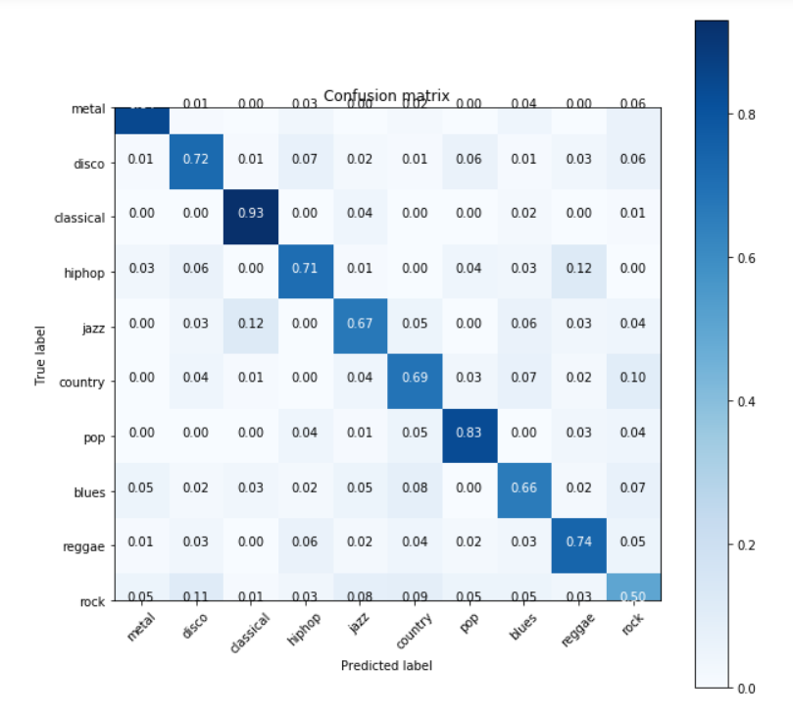
Logistic regression contd.
Mean Accuracy = 0.72900
Standard Deviation = 0.01562

Slide 10
Future work
So far we applied classic approach of machine learning to extract features and used a classifier
But for 2nd and final phase our goal is to apply deep learning approach where we can feed a CNN with a melspectrogram.
This is how we can compare between multiple architectures find the best approach to classify between song genres more accurately like human do.

